Slide 1
ForLens – A Lightweight AI-Driven Endpoint Security Solution for Real-Time Threat Detection in SMEs
25-26J-076

Slide 2
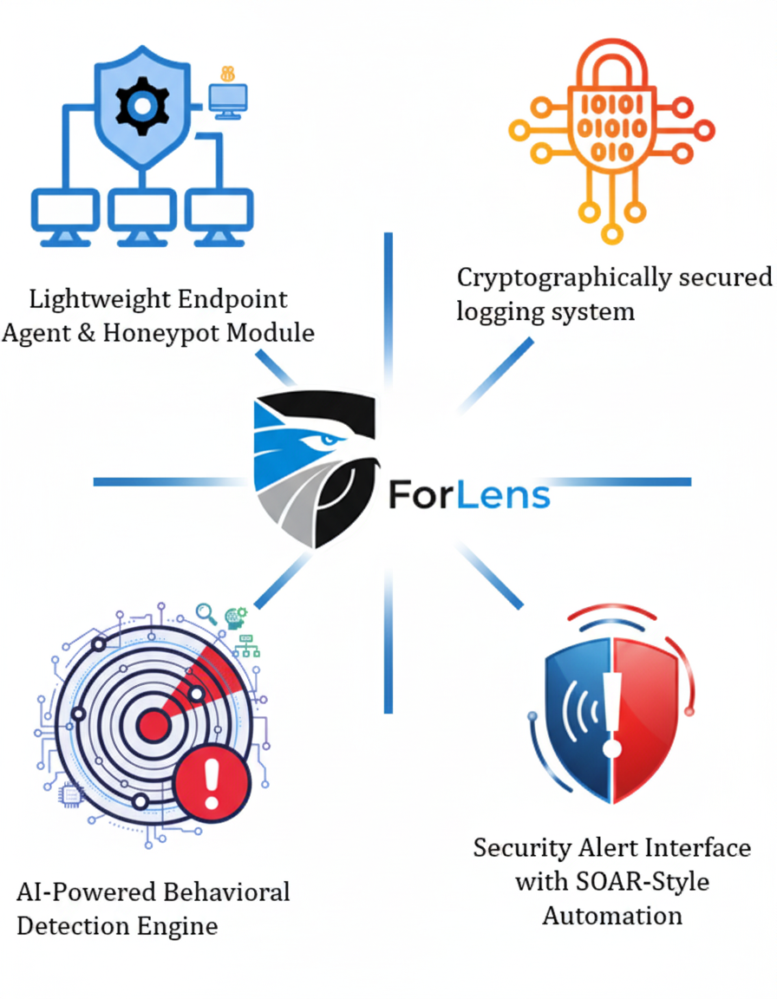





Overall Project Description
Research Problem
Small and medium-sized enterprises (SMEs) face a growing risk from threats, both malicious and accidental.
Enterprise-grade security tools (e.g., SIEMs, EDRs, SOAR platforms) are either too resource-intensive, costly, or complex for SMEs to adopt.
Most enterprise grade solutions utilize AI & ML algorithms which are black box in nature.
Forensic logging systems are often centralized and prone to tampering, making it difficult to ensure trustworthy evidence during incident response.
Cryptographically secured logging system
Lightweight Endpoint Agent & Honeypot Module
Security Alert Interface with SOAR-Style Automation
AI-Powered Behavioral Detection Engine

Slide 3



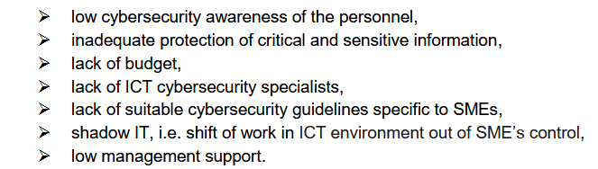
M. F. Arroyabe, C. F. A. Arranz, I. F. de Arroyabe, and J. C. F. de Arroyabe, "Revealing the realities of cybercrime in small and medium enterprises: Understanding fear and taxonomic
perspectives,"

Slide 4
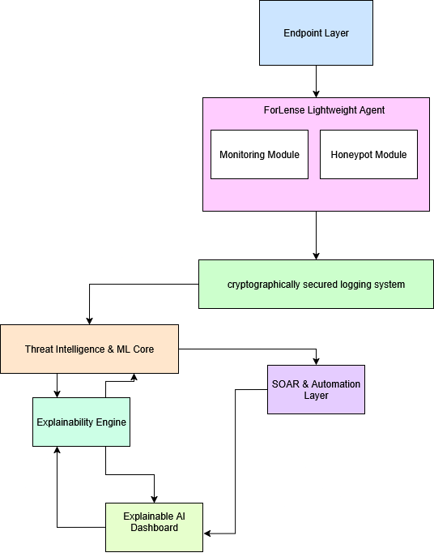
Objectives
Develop a Lightweight Endpoint Agent and Honeypot
Implement AI-Driven Behavior Modeling
Design Tamper-Evident Cryptographic Logging
Integrate a Lightweight SOAR-Style Automated Response System
• Evaluate the Effectiveness of ForLens

Slide 5
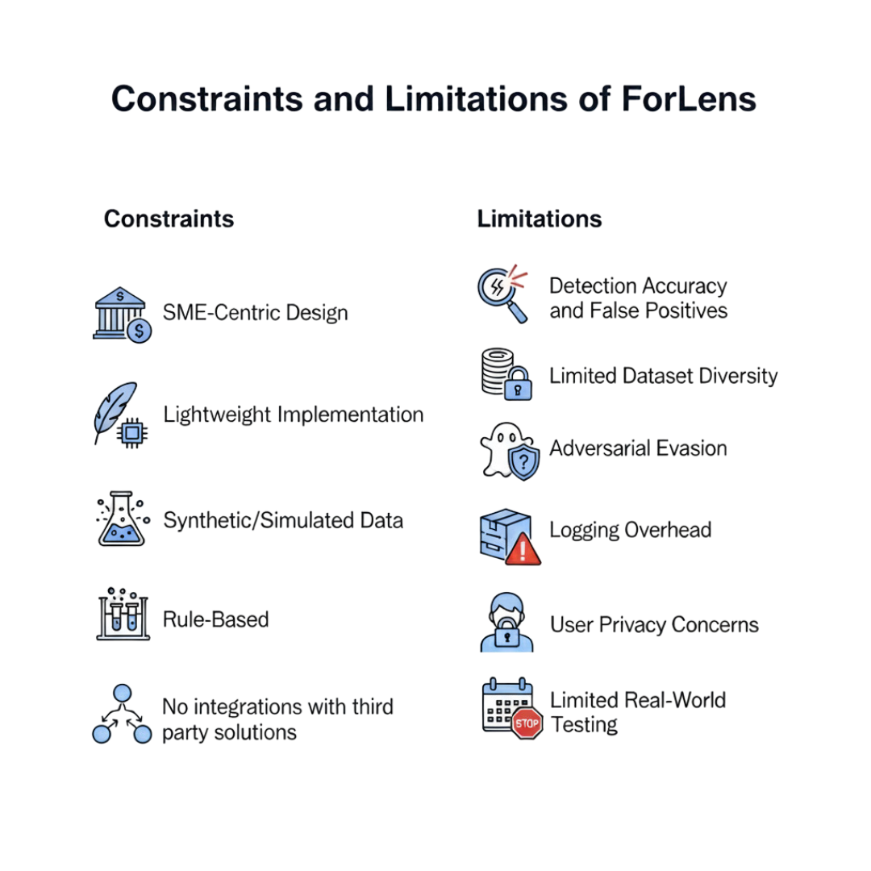

Slide 6


Student Must add
a professional
photo to this cage
Lightweight Endpoint Agent & honeypot Module
Specialization: Cyber Security
IT22908742 | MRF Nusfa | 25-26J-076
9/8/2025
6

Slide 7

Lightweight Endpoint Agent & Honeypot Module
Proven Gap
Knowledge gap
Existing honeypots are standalone
Not SME-friendly (complex setup, higher overhead)
No single lightweight agent that combines endpoint monitoring + honeypot for SMEs.
Weak stealth / tamper-proof resilience
No real-time correlation with SME endpoint activity
Research treats honeypots & anomaly detection separately
Very few combine deception with endpoint monitoring
Explainable AI rarely linked with endpoint deception for SMEs
Stealth/tamper-proof features mostly theoretical, not validated
Lack of plug-and-play models designed for SME constraints
Shortcomings of Existing Solution
Proposed System
Many commercial honeypots/EDR tools are expensive and require high resources, unsuitable for SMEs.
Existing lightweight honeypots are standalone and lack integration with endpoint monitoring.
Current tools provide limited visibility at endpoint level (focus more on network or server-side).
Most require skilled SOC teams to configure and operate, making them impractical for SMEs.
Continuous process/file/network monitoring with minimal resources
Lightweight endpoint agent with low-interaction honeypot
Stealth + tamper-resistant monitoring (hard to disable/remove)
Plug-and-play deployment, SME-optimized
IT22908742 | MRF Nusfa | 25-26J-076
7

Slide 8

Lightweight Endpoint Agent & Honeypot Module
Endpoint Security → monitoring processes, file changes, network connections.
Cyber Deception & Honeypots → tricking attackers with decoys, bait files, fake ports.
Intrusion Detection / Anomaly Detection → identifying unusual activity at endpoint level.
Network Security → forwarding telemetry securely (TLS/SSL), ensuring data confidentiality.
Security Engineering → designing stealth, tamper-resistant, and lightweight agents for SMEs
Technologies
Honeypot Frameworks: Low-interaction honeypot designs (Honeyd, Dionaea, Cowrie concepts adapted lightweight for SMEs).
Secure Telemetry: TLS/SSL encrypted telemetry forwarding to central analysis system.
Lightweight Monitoring Tools: Custom C/Python agents for file, process, and network monitoring with minimal overhead.
Stealth Techniques: Hidden processes and persistence methods to protect the agent from being disabled by attackers.
Deployment: Simple plug-and-play deployment models tailored for SMEs (minimal technical setup, easy installation.
Specialization Knowledge Applied
IT22908742 | MRF Nusfa | 25-26J-076
9/8/2025
8

Slide 9
Lightweight Endpoint Agent & Honeypot Module
Stealth & Tamper-Resilience Test → Ensure the agent cannot be disabled/removed by attackers.
Lightweight Performance → CPU/RAM usage ≤ 10% overhead on SME devices.
Forwarding Delay ≤ 5s → Telemetries are sent to the central system within seconds to avoid detection/response gaps.
Data & Ethical Clearance
Evaluation Data: Synthetic honeypot logs + controlled lab attack simulations (port scans, ransomware, insider behaviors).
No Real User Data: Only lab-generated traffic, no SME employee data collected.
Ethical Compliance: All experiments in safe, isolated lab setups with no risk to external systems.
Validation / Success Criteria
IT22908742 | MRF Nusfa | 25-26J-076

Slide 10
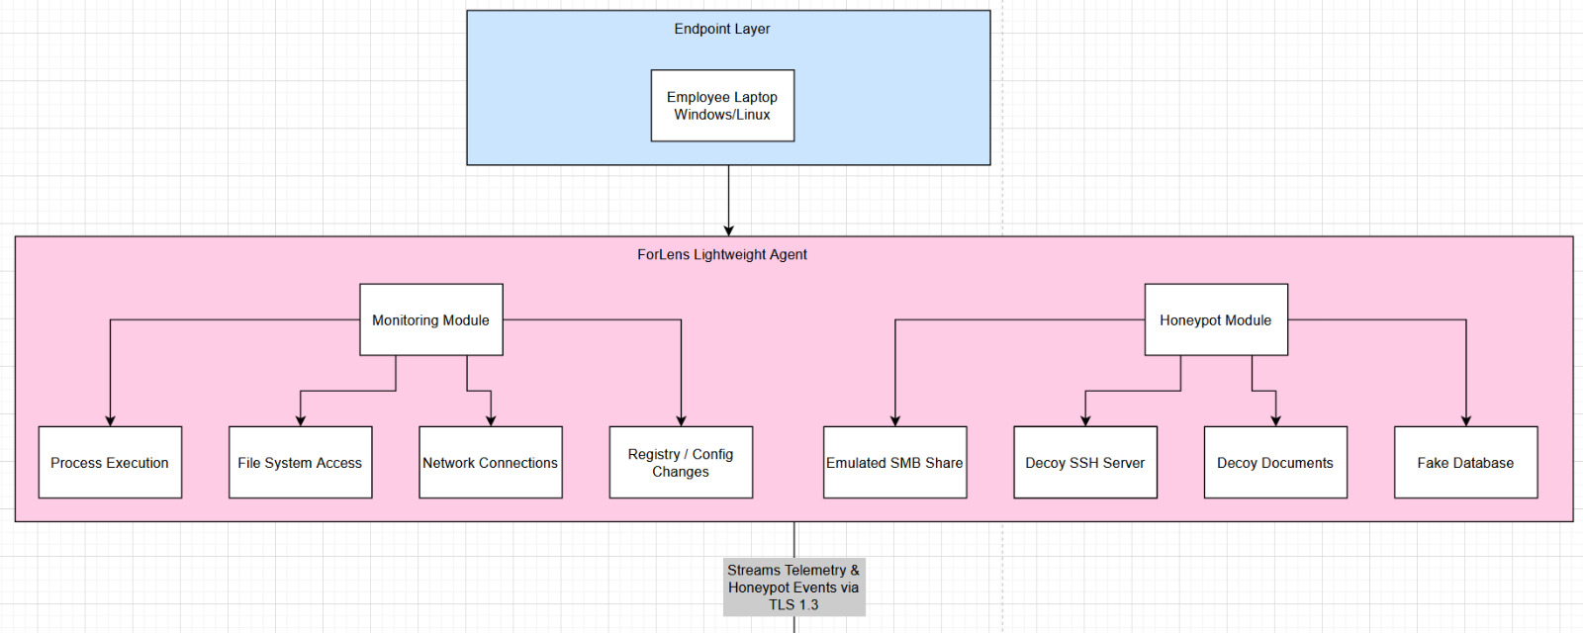
Lightweight Endpoint Agent & Honeypot Module
System Overview
Monitoring Module​
o Tracks process execution, file access, registry/config changes, and network connections.​
o Provides lightweight telemetry with ≤10% resource overhead.​
Honeypot Module​
o Deploys decoys (emulated SMB share for prototype).​
o Attracts attackers and captures malicious activity for analysis.​
Telemetry Forwarding​
o Secure TLS/SSL transmission of endpoint + honeypot events to central analysis engine.​
o Ensures confidentiality and integrity of data.
​
Stealth & Resilience​
o Hidden operation mode, resistant to tampering or disabling by attackers.​
SME Optimization​
o Plug-and-play deployment, minimal setup complexity, designed for resource-limited SME devices.
IT22908742 | MRF Nusfa | 25-26J-076

Slide 11
Lightweight Endpoint Agent & Honeypot Module
Real-World Usage
🔹 SME Deployment
IT teams install the agent on employee devices, servers
No expert SOC knowledge needed — setup is plug-and-play.
🔹 During an Attack
If an attacker tries to access sensitive files, fake SSH, or database decoys → honeypot is triggered.
Monitoring module records the suspicious process/network activity in real time.
Events are immediately forwarded to the central analysis engine.
🔹 Response in Practice
The central analysis system generates the response, and the endpoint agent enforces it automatically. Depending on the playbook, the agent can block malicious processes or repair system changes, ensuring quick containment without manual effort
🔹 Business Impact
Prevents attackers from reaching real assets by misleading them into honeypots.
Gives SMEs early warning and forensic data without heavy infrastructure.
Keeps resource overhead <10%, making it affordable and practical.
IT22908742 | MRF Nusfa | 25-26J-076

Slide 12

AI – Powered Behavioral Detection Engine
Specialization: Cyber Security
IT21289934 | Salgado M B D | 25-26J-076
9/8/2025
12

Slide 13




AI – Powered Behavioral Detection Engine
Proven Gap
Knowledge Gap
❌ Heavy EDR/XDR → Not SME-friendly
❌ Rule-based → Misses stealth threats
✅ Lightweight ML + TI detection
No integrated Anomaly + TI detection
High false positives for SMEs
Shortcomings of Existing Systems
Proposed Solution
Unsupervised ML models
Open-source TI feeds (OTX, MISP, AbuseIPDB)
Explainable alerts, low false positives
Costly & resource-heavy
Poor real-time TI integration
Depend on large SOC teams
IT21289934 | Salgado M B D | 25-26J-076
9/8/2025
13

Slide 14
AI – Powered Behavioral Detection Engine
Specialization Knowledge Applied
Technologies
Cybersecurity: Knowledge of endpoint monitoring (logon events, file access, process execution) and insider threat behaviors is applied to model real-world SME attack surfaces.
Machine Learning / AI: Advanced ML techniques like Isolation Forests (detect outliers) and LSTM Autoencoders (model normal user sequences and detect abnormal patterns) are applied for anomaly detection.
Data Engineering: Expertise in at preprocessing, feature extraction (e.g., login frequency, file activity bursts, USB use), and log normalization ensures raw logs can be transformed into structured, ML-ready inputs.
ML Frameworks:
  TensorFlow, PyTorch For deep learning models (LSTM Autoencoders).
  Scikit-learn For classical anomaly detection (Isolation Forest).
Threat Intelligence (TI) Sources:
  OTX (AlienVault), MISP, AbuseIPDB, VirusTotal Integrated via APIs to enrich anomalies with contextual IOC data (e.g., “this IP is part of a known botnet”).
Processing:
  Pandas & NumPy For efficient log preprocessing and feature generation.
IT21289934 | Salgado M B D | 25-26J-076
9/8/2025
14

Slide 15
AI – Powered Behavioral Detection Engine
Validation / Success Criteria
Data & Ethical Clearance
Target Accuracy ≥ 90% ML models should correctly classify normal vs. abnormal user behavior with minimal errors.
False Positives ≤ 5% Key metric for SMEs (alerts must be meaningful to avoid alert fatigue).
Real-time Alerts < 2s Latency System must detect and push alerts almost instantly to be actionable.
Dataset: CERT Insider Threat Dataset (CMU) Well-known, anonymized dataset with simulated insider behaviors.
Threat Intel (TI): OSINT feeds (AlienVault OTX, AbuseIPDB, VirusTotal, MISP) Free, community-driven, no private data.
Ethics: No real employee data is collected. All datasets are synthetic or anonymized, ensuring privacy compliance.
IT21289934 | Salgado M B D | 25-26J-076
9/8/2025
15

Slide 16
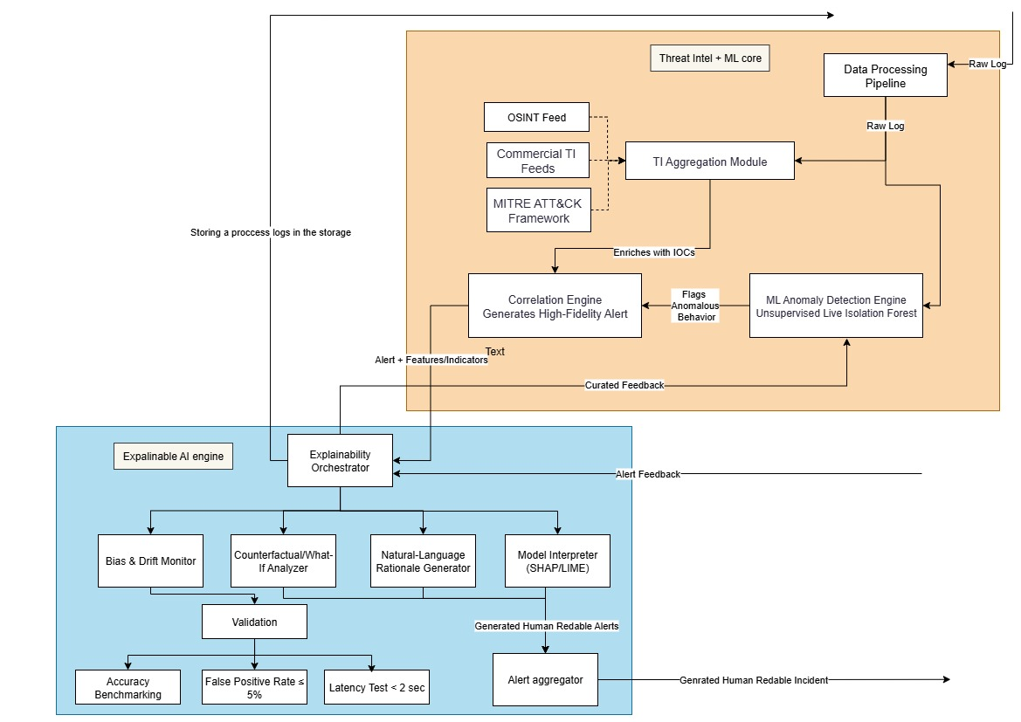
AI – Powered Behavioral Detection Engine
System Overview
🔹 Log Collection & ML Detection
  Agents collect activity logs
  AI models (Isolation Forest, Autoencoder) find unusual behavior
🔹 Threat Intelligence Enrichment
  Alerts checked against global feeds (OTX, MISP, AbuseIPDB, VirusTotal)
  Adds context: “This IP is known malicious”
🔹 Explainable Engine (New Addition)
  Bias & Drift Monitor → Keeps ML accurate over time
  What-If Analyzer → Explains why it was flagged
  Rationale Generator → Turns alerts into plain English
  Model Interpreter (SHAP/ LIME) → Shows which features caused the detection
  Dashboard → Clear view with risk score, MITRE mapping, audit log
IT21289934 | Salgado M B D | 25-26J-076
9/8/2025
16

Slide 17
AI – Powered Behavioral Detection Engine
Real-World Usage
🔹 Deployment in SMEs
  Install lightweight agents on employee devices (Windows/Linux).
  Agents forward logs (logins, file access, processes, network activity) securely to the ForLens backend.
🔹 Detection & Enrichment
  ML engine analyzes behavior → flags unusual activity.
  Threat Intelligence (OTX, MISP, AbuseIPDB, VirusTotal) adds context:
  e.g., “Suspicious login from blacklisted IP.”
🔹 Explainability for Actionability
  Dashboard displays alerts in plain English with:
    Why it was flagged (after-hours login, USB anomaly)
    Which features caused the detection (time, process, IP reputation)
    Risk score (critical / medium / low)
    MITRE ATT&CK mapping (where it fits in attack chain).
🔹 Response for SMEs
  Security admin (or even IT staff without SOC expertise) gets actionable alerts.
  Example: “User X logged in at 2 AM from a malicious IP. Risk: Critical. Suggested response: temporary account lock.”
  Enables SMEs to respond quickly without needing a large SOC team.
IT21289934 | Salgado M B D | 25-26J-076
9/8/2025
17

Slide 18


Cryptographically Secured Logging System
Specialization: Cyber Security
9/8/2025
18

Slide 19
Cryptographically Secured Logging System
Proven Gap
Knowledge gap
SMEs are forced to choose between security, performance, and cost.
No commercial logging product offers tamper-proof integrity, data confidentiality, and high performance at an SME-affordable price.
A clear market gap exists for a lightweight, all-in-one secure logging solution.
  No published work provides a unified architecture that combines Merkle Trees (for efficiency), Forward Security (for long-term integrity), a crash-resilient protocol (for robustness), and Selective Encryption (for compliance) into a single, lightweight system designed for endpoint constraints.
Shortcomings of Existing Solution
Proposed System
Tamper-proof but slow verification.
Immutable but very high cost, latency, and storage overhead.
Often lack crash-resilience, confidentiality, or are not designed for lightweight deployment.
Using Merkle Trees for fast auditing.
Detects tampering even after a system crash.
Protects sensitive PII for GDPR/HIPAA compliance.
Uses blockchain as a cheap, immutable witness for trust.
9/8/2025
19

Slide 20

Cryptographically Secured Logging System
Key Domains of Specialization
Cryptography
  Merkle Trees, Forward-Secure Signatures, AES-256-GCM Encryption.
Security Engineering
  Crash-Consistency Protocols, Secure API Design, Tamper-Evidence.
Compliance Engineering
  Technical implementation of GDPR/HIPAA via Selective Encryption.
Lightweight Architecture
  Designing for low CPU/RAM overhead on endpoint devices.
Technologies
Python & PyCryptodome
  For cryptographic operations (hashing, signing, encryption).
Merkle Trees
  For efficient O(log n) integrity verification.
Lightweight DB (SQLite)
  For secure storage on the endpoint.
Blockchain (Ethereum/QLDB)
  For cost-effective, hybrid trust anchoring.
9/8/2025
20

Slide 21
Cryptographically Secured Logging System
Validation / Success Criteria
Detection Accuracy = 100%
  Tampering, crash-attacks, and key compromise must be detected every time.
Performance Overhead ≤ 10%
  CPU/RAM usage must be minimal on SME-grade hardware.
Verification Time < 10ms
  For a single log in a set of 1 million entries.
Storage Overhead ≤ 15%
  Compared to plain text logs.
Real-Time Operation
  Log processing and integrity checks must occur in real-time.
Data & Ethical Clearance
Dataset: Synthetic log data generated to test all attack scenarios.
No Real User Data: Only simulated events and anonymized data will be used.
Ethical Compliance: All testing confined to a controlled lab environment.
9/8/2025
21

Slide 22
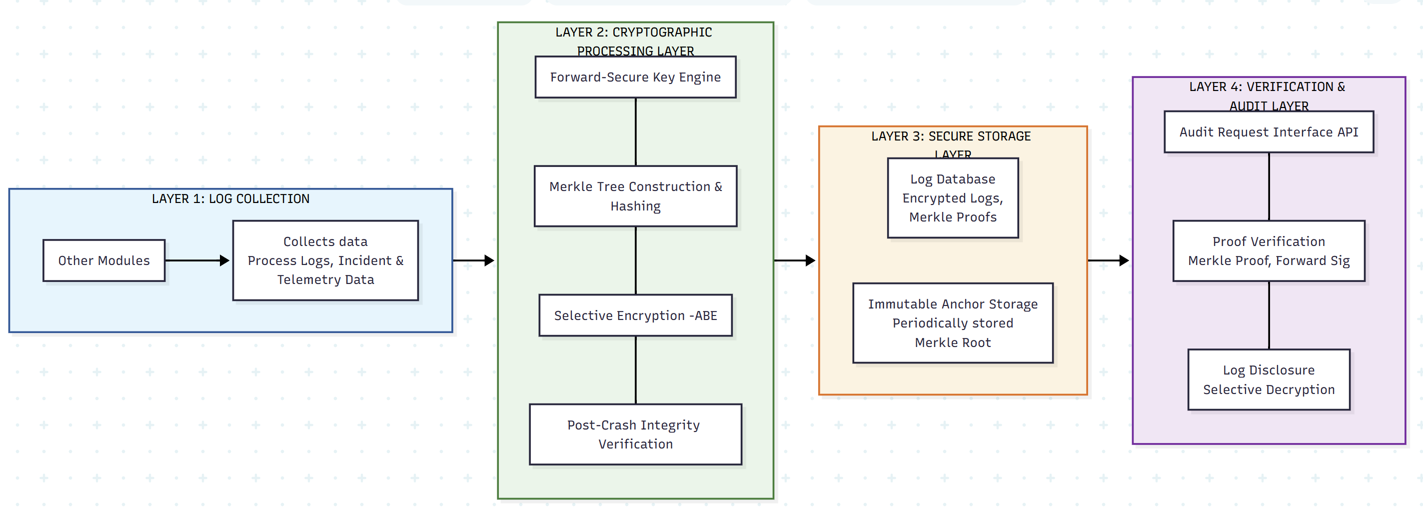
Cryptographically Secured Logging System
System Overview
real-world scenarios
Attackers hide tampering by causing a system crash.
A persistent, crash-proof "checkpoint" file is maintained. Any mismatch on reboot is proof of pre-crash tampering.
A stolen key is being used to forge past logs. Also makes signing efficient.
Keys evolve forward and can't be reversed. Only the single Merkle Root of a log batch is signed, not every log.
Keeping sensitive data (PII) in logs private, while still allowing integrity verification.
Only sensitive fields are encrypted. The entire log entry (ciphertext + plaintext) is hashed, so tampering with anything is detected.
Preventing a powerful attacker from replacing the entire log system with a fake one.
Periodically, a tiny fingerprint (Merkle Root) of the logs is published to an immutable blockchain, creating a permanent, external point of truth.
9/8/2025
22

Slide 23

Student Must add
a professional
photo to this cage
Security Alert Interface with SOAR-Style Automation
Specialization: Cyber Security
IT22340078 | SANJULA E A Y | 25-26J-076
9/8/2025
23

Slide 24




Security Alert Interface with SOAR-Style Automation
Proven Gap
Knowledge Gap
Existing Systems
Solution
The Usability Gap – lack of technical experts
The Resource Gap – small budgets
The Trust Gap - AI systems create a "black box" problem
The Operational Gap - need for constant, expert-level manual tuning
Cortex XSOAR, QRadar and Splunk (enterprise grade)
Wazuh (open source free)
Expertise Required
Costly
Open source tools are far behind enterprise grade tools
Limited research done on building enterprise grade solutions to SMEs.
Limited Research on building dashboards and SOAR solutions focused on non technical individuals.
Dynamic Playbook Creation and Modification
Autonomous threat containment without SOC dependency (SOAR style)
Dashboard for non-technical individuals
Explainable & Context Aware AI
IT22340078 | SANJULA E A Y | 25-26J-076
9/8/2025
24

Slide 25







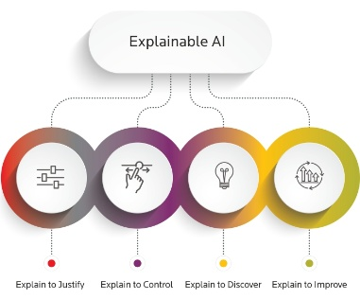
Security Alert Interface with SOAR-Style Automation
Specialization based Knowledge
Ethical Clearance
Data Availability
Public Cyber Security data sets (CIC-IDS-2017)
Open-source threat intelligence feeds (OTX, Virustotal)
Data received from POC testing and module integrations
Non-Human Subjects Research
Data Anonymization and Privacy
Responsible AI Development
Latest Technologies
How To Evaluate
Functional Validation: test case execution & data set validation.
Performance Metrics: Mean Time to Respond (MTTR) , Alert Reduction & False Positive rates.
Usability & Trust Assessment.
IT22340078 | SANJULA E A Y | 25-26J-076
9/8/2025
25

Slide 26


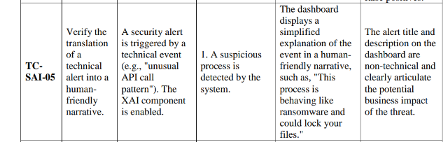

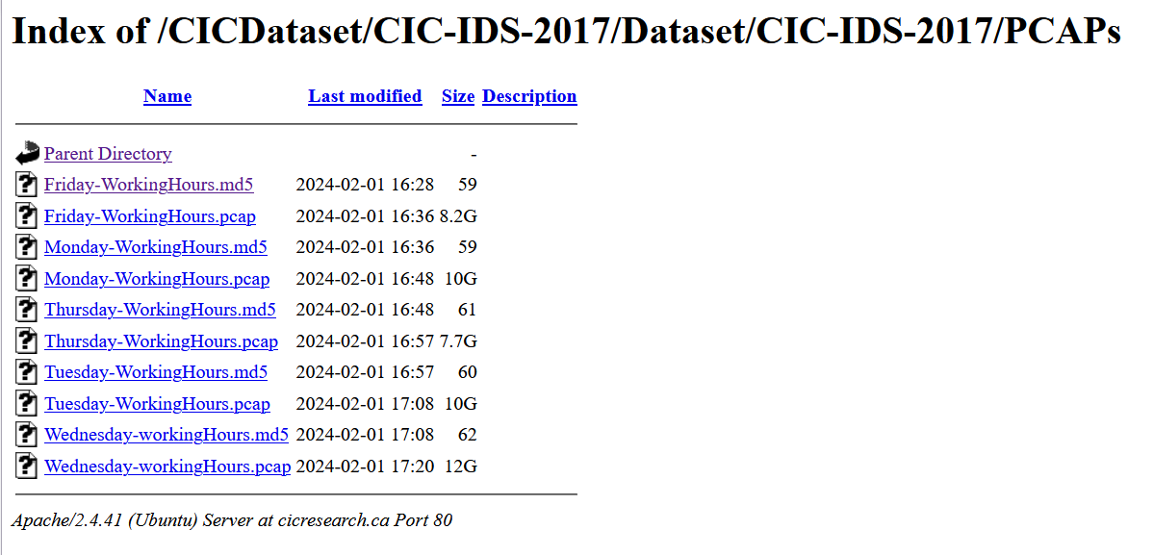

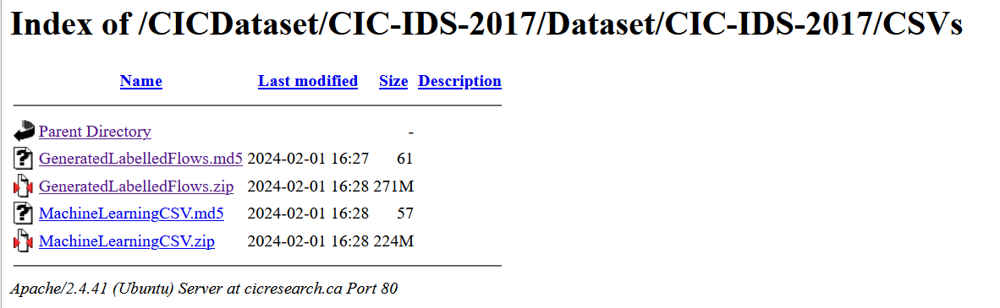
Security Alert Interface with SOAR-Style Automation
How To Evaluate
Functional Validation: test case execution & data set validation.
Performance Metrics: Mean Time to Respond (MTTR) , Alert Reduction & False Positive rates.
Usability & Trust Assessment.
Non-technical user usability
Automate 50% of
the tasks performed by analysts
Detection accuracy of at least 90%
reduce MTTR by up to 80% or greater
IT22340078 | SANJULA E A Y | 25-26J-076
9/8/2025
26

Slide 27
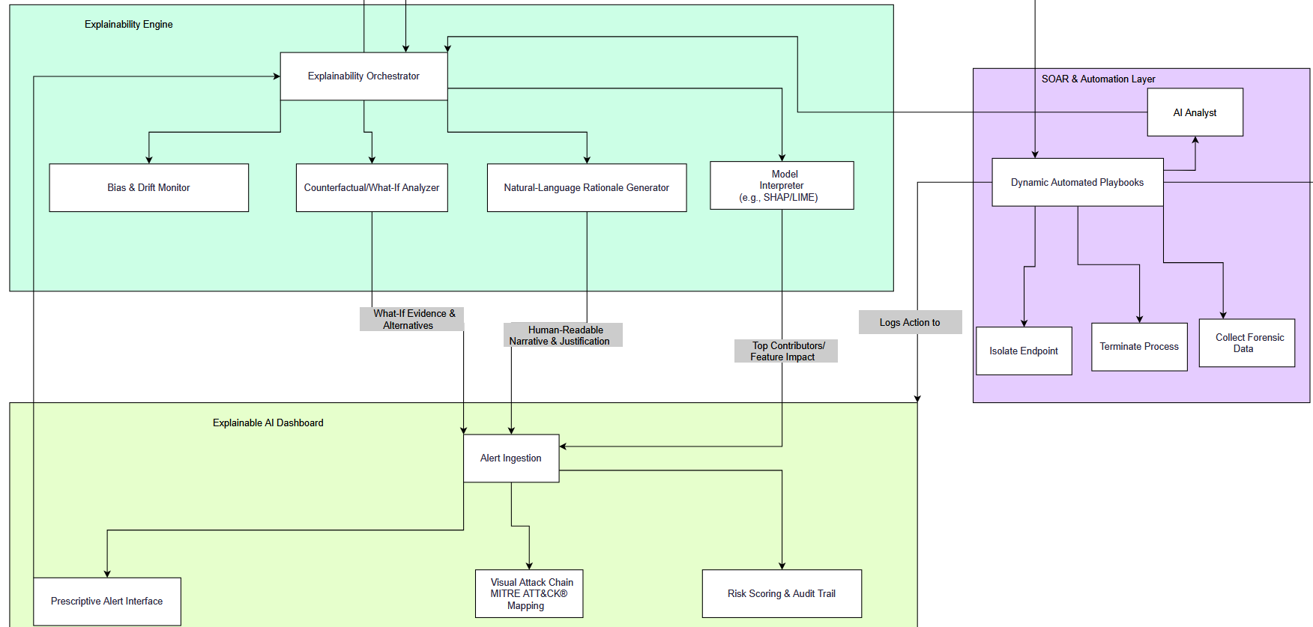
Security Alert Interface with SOAR-Style Automation
Real World Usage
Simple and Proactive Security: Unified dashboard, self learning.
Fast and Automated Response: Immediate actions, automated workflows, One click control
Advanced benefits: Custom playbooks, Automated & business reporting
IT22340078 | SANJULA E A Y | 25-26J-076
9/8/2025
27

Slide 28

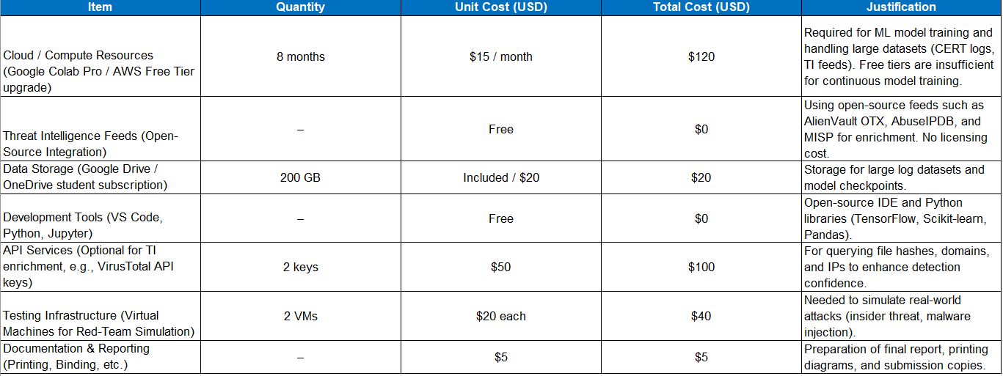
Commercialization
Market Gap: SMEs face Cyber threats but can’t afford enterprise tools (e.g., Splunk, Varonis) and lack technical expertise.
Value Proposition: Lightweight, AI-driven detection + honeypot traps + tamper-proof logging + SOAR-like automation, all SME-friendly.
Target Market: SMEs; Managed Service Providers (MSPs).
Business Model: SaaS subscription (per endpoint/month)
Advantages: Affordable, scalable, compliance support, unique vs. open-source tools.
Challenges: Competing with free tools, reducing false positives, scaling support.
Roadmap: Prototype → MVP pilot with SMEs → SaaS subscription → MSP partnerships → Expansion.
Source: World Bank
Real World Usage
Simple and Proactive Security: Unified dashboard, self learning.
Fast and Automated Response: Immediate actions, automated workflows, One click control
Advanced benefits: Custom playbooks, Automated & business reporting
Total Investment for prototype with buffer: $485
9/8/2025
28

Slide 29
References
M. F. Arroyabe, C. F. A. Arranz, I. F. de Arroyabe, and J. C. F. de Arroyabe, "Revealing the realities of cybercrime in small and medium enterprises: Understanding fear and taxonomic perspectives,“
European Union Agency For Cybersecurity, June 2021, “Cybersecurity for SMEs – Challenges and Recommendations. [Online]. Available: https://www.enisa.europa.eu/publications/enisa-report-cybersecurity-for-smes
C. Gates, et al., “Detecting Insider Threats in Logs,” CERT, CMU, 2011.
IBM, “IBM QRadar SIEM Overview,” 2023.
AlienVault, “Open Threat Exchange (OTX),” [Online]. Available: https://otx.alienvault.com
AbuseIPDB, “IP Blacklist & Threat Feed,” [Online]. Available: https://www.abuseipdb.com

